Slide 1

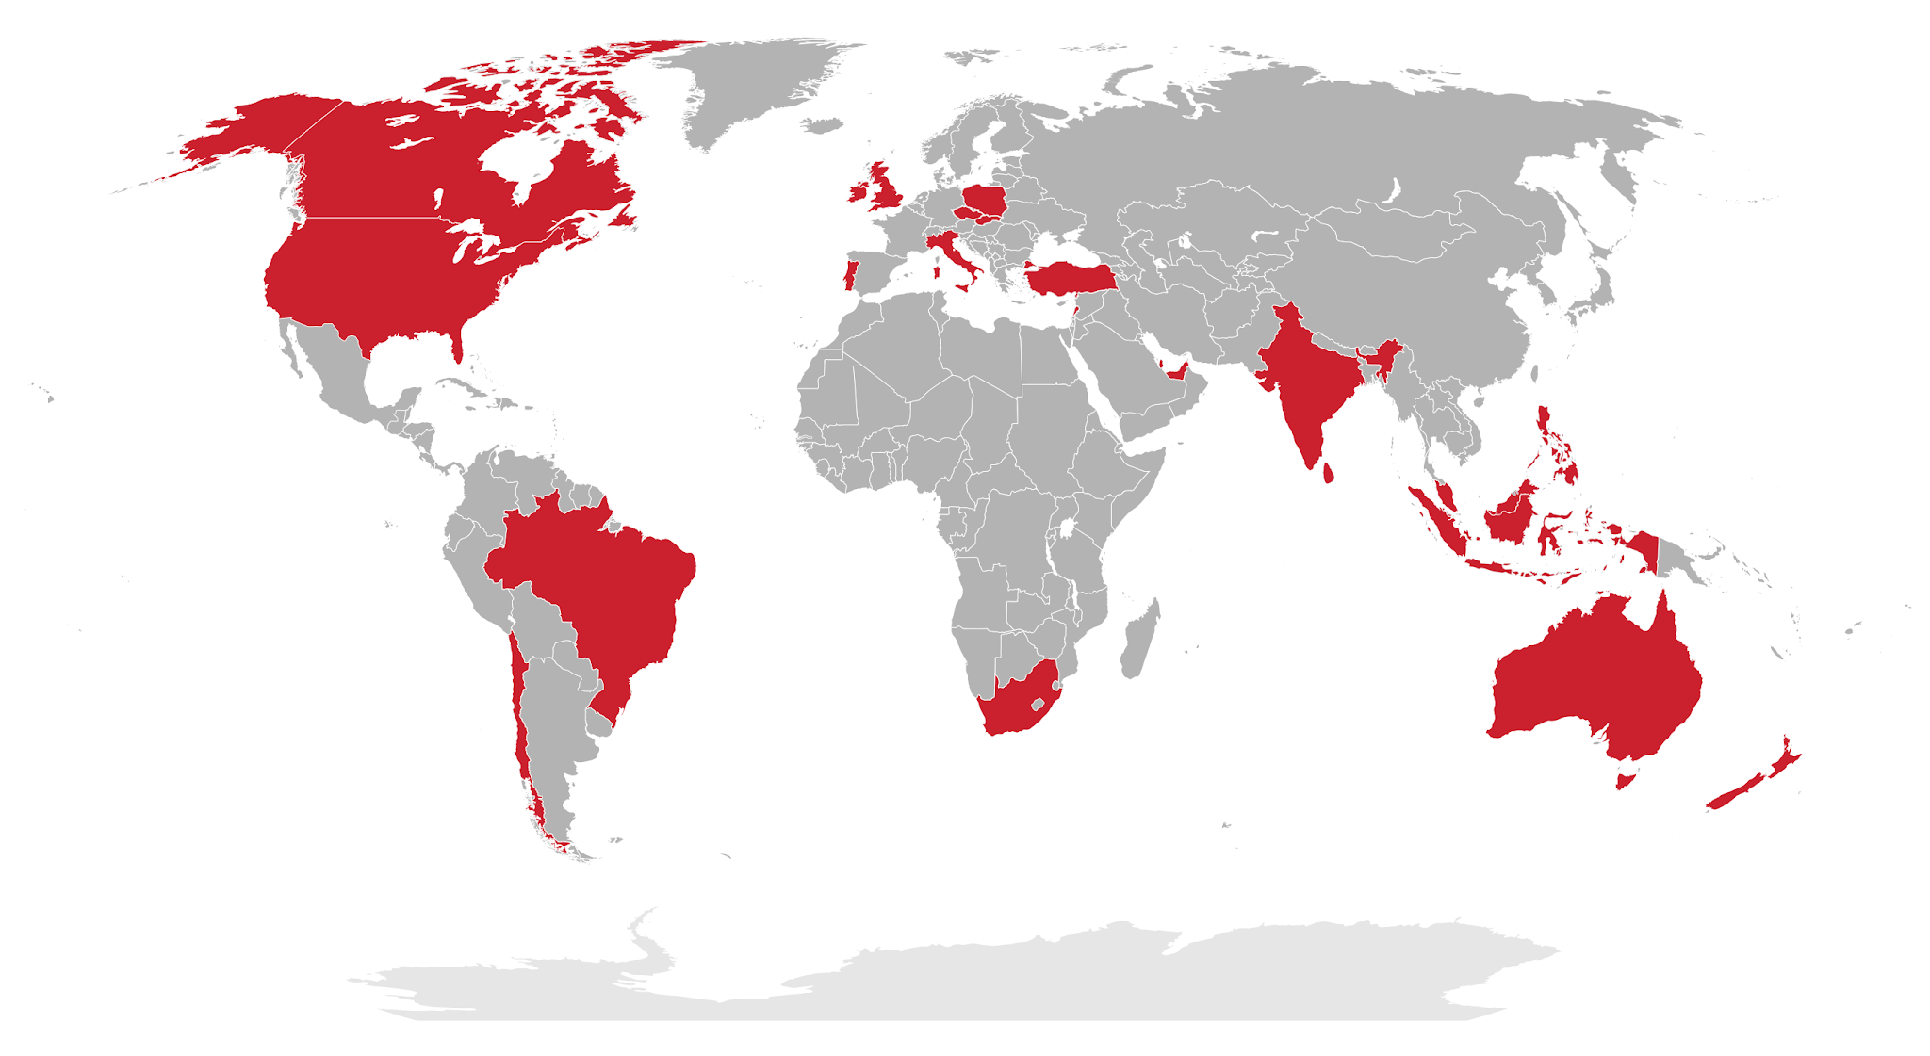
Project
Indian multinational
restaurant aggregator
and food delivery
company
By - Ujjwal
DS May 2024 Batch

Slide 2
Introduction
Overview of the Current Restaurant Landscape:
The global restaurant industry has witnessed significant growth over the past decade.
There are thousands of restaurants worldwide, catering to diverse culinary preferences.
Trends include increasing demand for diverse cuisines, a rise in online food delivery services, and a shift towards sustainable and healthy dining options.
Statement of the Problem and the Goal of Expansion:
Despite the industry's growth, certain regions remain under-served with limited restaurant options, presenting opportunities for new entrants.
Goal: To strategically expand into these underserved regions, leveraging data-driven insights to identify areas with lower competition and high growth potential

Slide 3
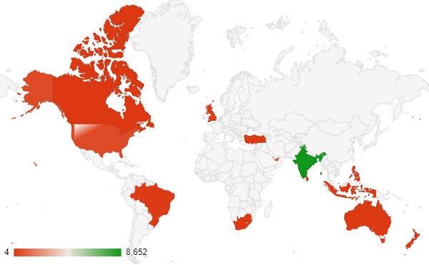
Global Overview
Number of Restaurants Worldwide:
The global restaurant industry consists of 9,552 restaurants in the dataset.
Total Number of Restaurants in the Global Dataset:
Display the total number of restaurants: 9,552.
Distribution of Restaurants by Country:
we can observe that India has the highest number of restaurants, indicating a potentially large market for food-related businesses. The United States, United Kingdom, and United Arab Emirates also have significant numbers of restaurants, suggesting they are competitive markets. Conversely, Canada has relatively few restaurants, which could indicate
lower competition or a smaller market.

Slide 4
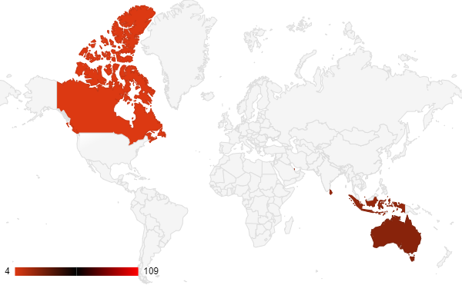
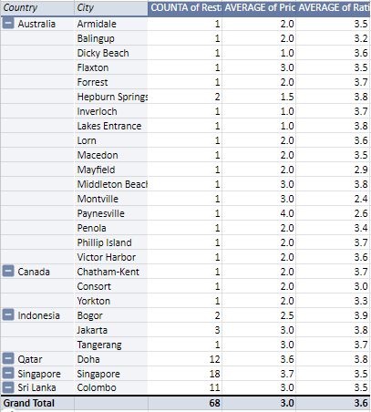
Expansion Opportunities
Map Highlighting Countries with Lower Competition:
Australia,Canada,Indonesia,Qatar,Singapore,Sri Lanka.
Table Listing Suggested States and Cities for New Restaurants:
Number of states and cities for new restaurant is 26
The current number of restaurants in the suggested state and cities is 68

Slide 5
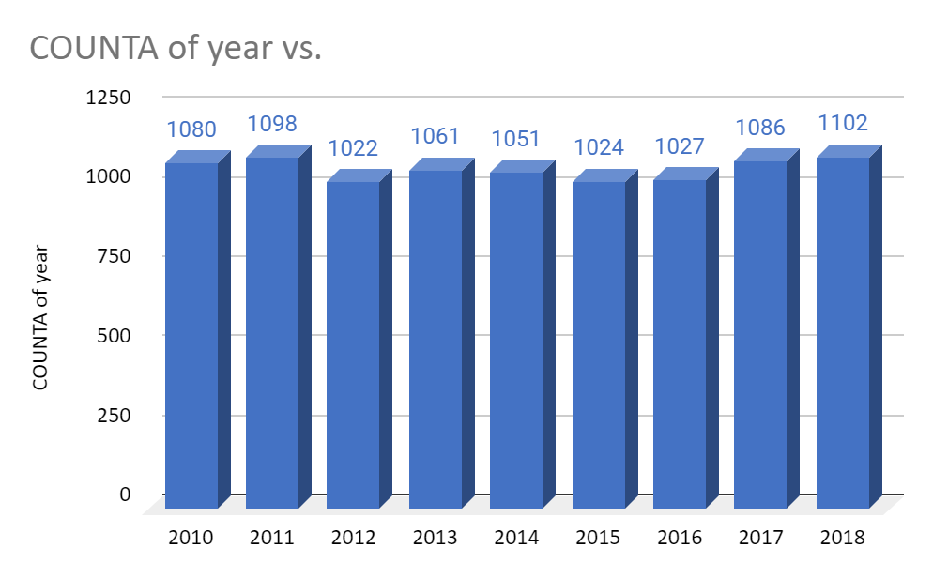
Market Trends
The number of restaurant openings over time.
Overall, there is a fluctuating trend in restaurant openings over the years, with some years showing an increase and others showing a decrease.
There was a slight decline in restaurant openings from 2012 to 2015, followed by a gradual increase from 2015 to 2018.
The highest number of restaurant openings was observed in 2018, indicating a potential upward trend in the industry.
This trend suggests that there may be opportunities for expansion, especially considering the recent increase in restaurant openings.

Slide 6
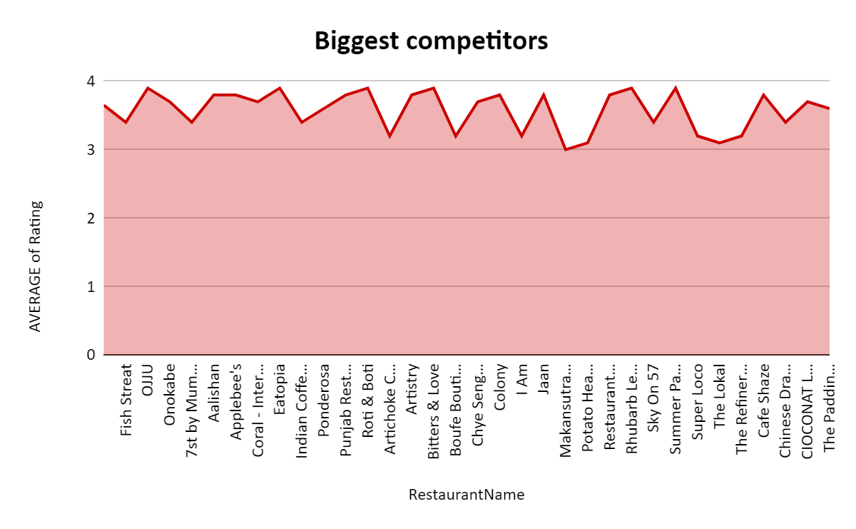
Competitive Landscape
Biggest competitors

Slide 7
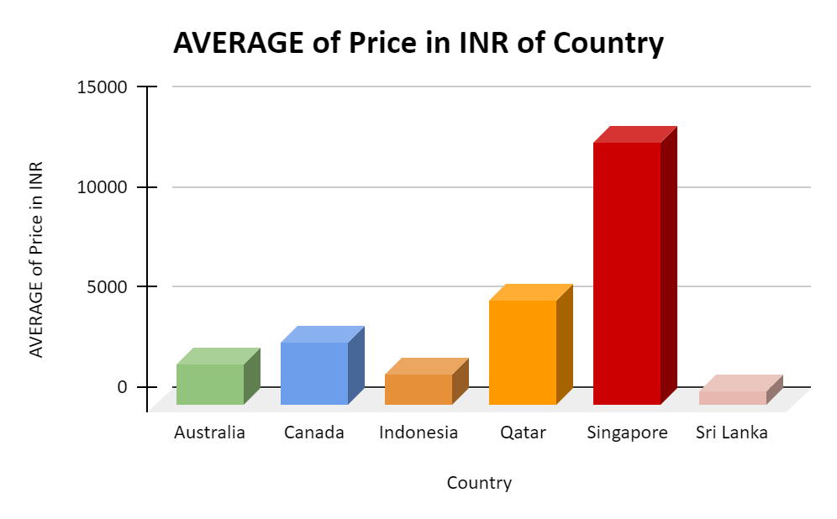
Financial Considerations
column Chart Displaying the Average Expenditure on Food in Suggested Countries:
The average expenditure on food varies significantly across the suggested countries, with Singapore showing the highest average expenditure.
Factors such as the cost of living, currency exchange rates, and local food preferences may influence pricing trends in these countries.

Slide 8
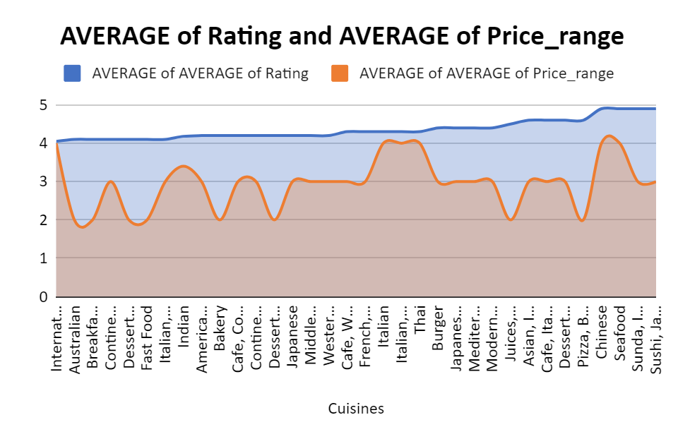
Cuisine Recommendations
These cuisines are selected on the basis of rating.
They have highest rating
Consider these popular cuisine types to attract a wider audience and enhance the dining experience.

Slide 9
Summary of Key Findings
Analysis of the restaurant landscape revealed a distribution of restaurants by country, with opportunities for expansion in countries with lower competition.
Market trends indicate a steady increase in restaurant openings, reflecting a growing demand for dining options.
The competitive landscape highlights key competitors, their ratings, and key metrics, providing insights into the market dynamics.
Financial considerations, such as the average expenditure on food in suggested countries, indicate varying pricing trends and cost factors to consider.

Slide 10
Recommendations for Strategic Expansion
Consider expanding into countries with lower competition and high demand for popular cuisines such as Italian, Chinese, Seafood, Sushi, and others.
Focus on enhancing the dining experience, offering a variety of popular cuisine types, and maintaining competitive pricing to attract a wider audience.
Implement strategies to improve customer satisfaction, increase profitability, and establish a strong presence in the target market.

Slide 11
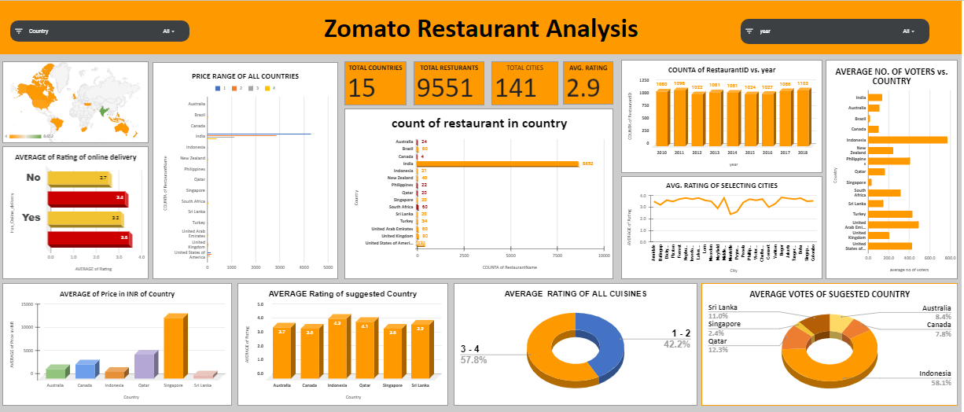

Slide 12
THANK YOU

